Slide 1

Array
group of related data types sharing a common name

Slide 2
Array
1D Array
2D Array
Element | 1st element a[0] | 2nd element a[1] | 3rd element a[2] | 4th element a[3] | 5th element a[4]
Address | 2000 | 2002 | 2004 | 2006 | 2008
 | *(a) | *(a+1) | *(a+2) | *(a+3) | *(a+4)
 | Column 1 | Column 2 | Column 3
Row 1 | x[0][0] | x[0][1] | x[0][2]
 | *(*(x+0)+0) | *(*(x)+1) | *(*(x)+1)
Row 2 | x[1][0] | x[1][1] | x[1][2]
 | *(*(x+1)+0) | *(*(x+1)+1) | *(*(x+1)+2)
Row 3 | x[2][0] | x[2][1] | x[2][2]
 | *(*(x+2)+0) | *(*(x)) | *(*(x+2)+2)

Slide 3

Pointers
Variable that contains memory address of another variable

Slide 4
Pointers
Reference operator (&)
Used to get address of the variable
Dereference operator (*)
Used to get the value pointed by the pointer

Slide 5

Dynamic Memory
Process of allocating and freeing memory at runtime

Slide 6
Dynamic Memory
new and new[] operator
delete and delete[] operator

Slide 7
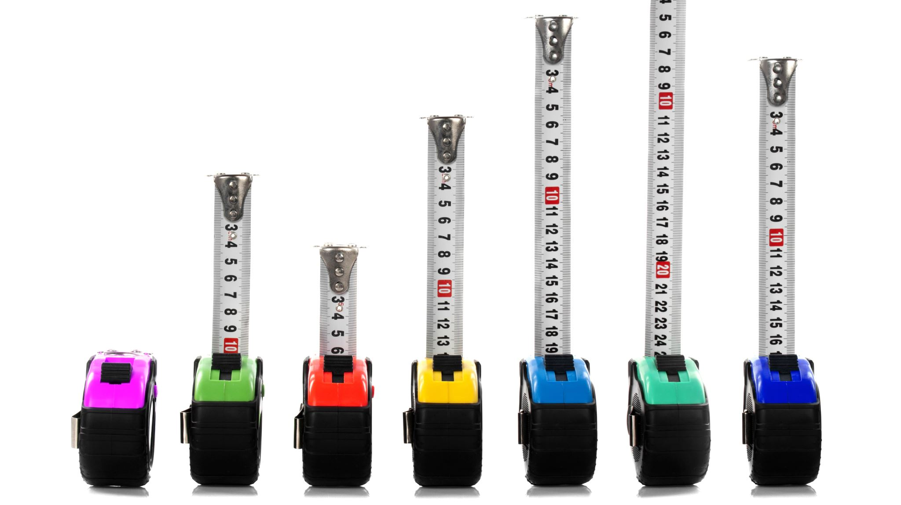
Manipulators
Special type of function used to format output as user’s requirements

Slide 8
Enumeration
Process of naming data with numerical values

Slide 9

String
Array of characters

Slide 10
String Handling functions
strlen()
strcpy()
strcat()
strcmp()
strrev()

Slide 11
get and getline() functions

Slide 12

Reference Variable
Alias (i.e. other name) for a variable, similar to pointer with few key differences

Slide 13
Differences between pointer and reference variables
A reference variable can’t be reassigned after initialization
References can’t be null
References cannot be un-initialized

Slide 14
Next Class
Functions in C++

